Slide 1
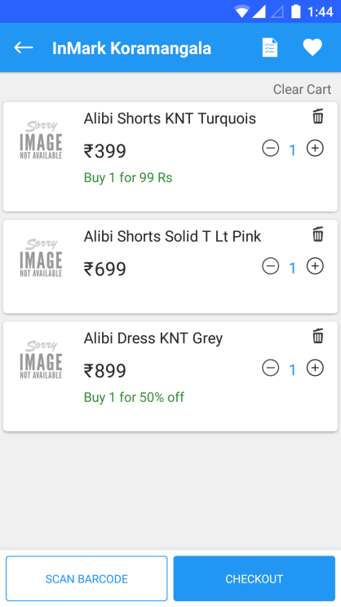
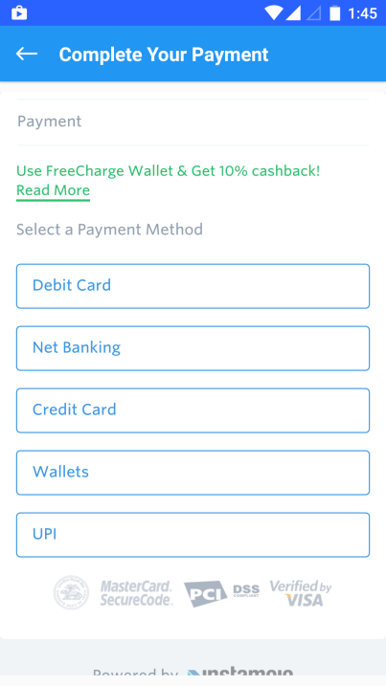



Customer shops via Perpule Self Checkout App at Inmark Stores
Customer scans and adds products
Customer pays in App via Credit/Debit Card, Net Banking, UPI or Wallets
Bill amount is received by Instamojo Payment Gateway
Bill amount is credited to Inmark’s Bank Account on T+2

